Slide 1
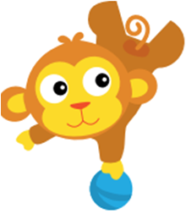

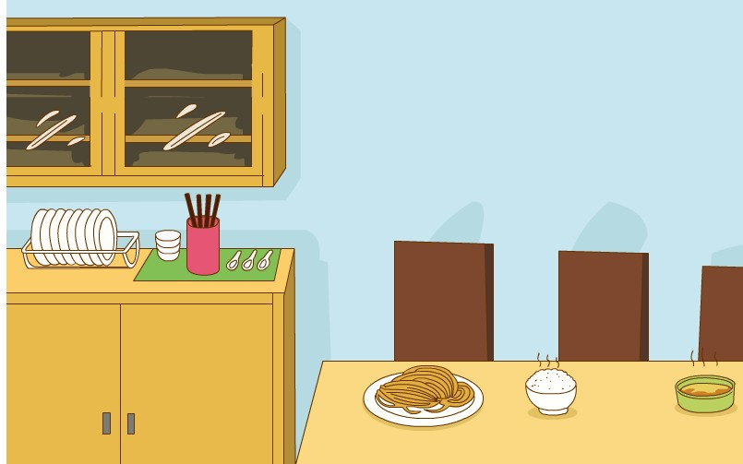
Dinner is ready！
2

Slide 2



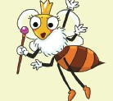
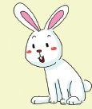
queen bee
rabbit
Q for queen bee.
R for rabbit.
Notes:
While-task procedure 11:
活动内容：字母学习
操作方法：通过单词或是句子引出字母的发音

Slide 3
The queen bee flies around.
The rabbit runs around.

Slide 4
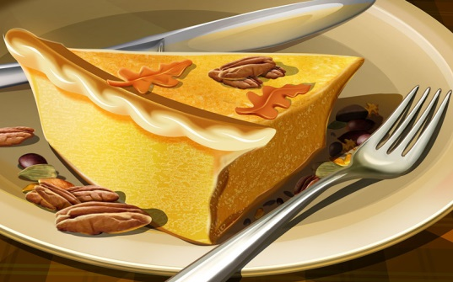
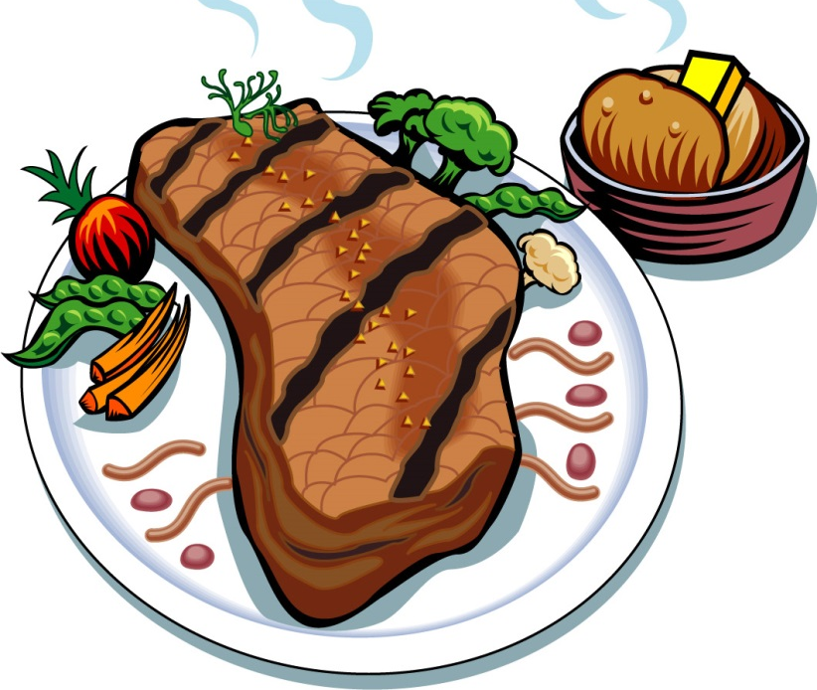
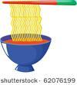
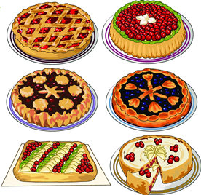

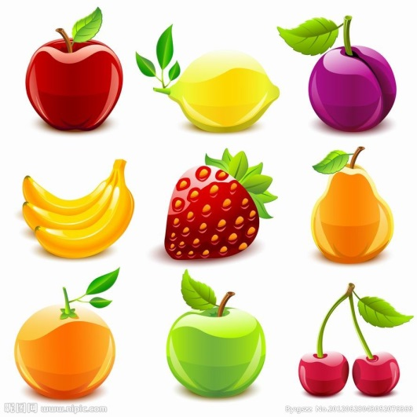
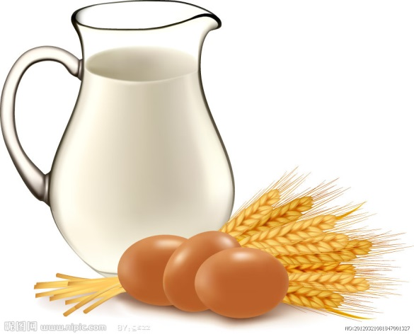
Dinner is ready!
Notes:
Pre-task preparation 1:
活动内容：Picture show
操作方法：引出主题 Dinner is ready

Slide 5
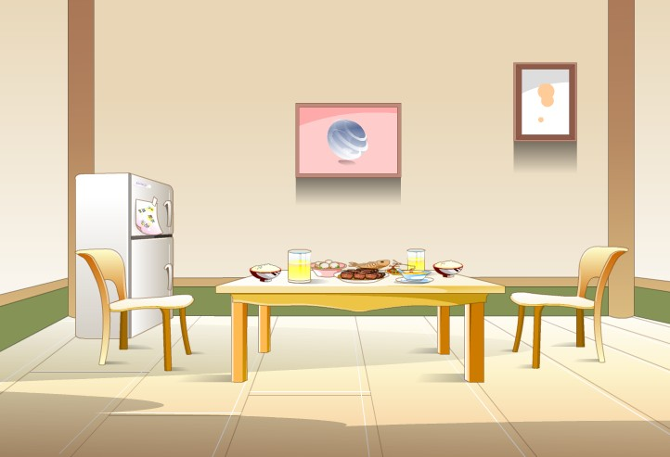
What do you want for dinner?
Notes:
Pre-task preparation 2:
活动内容：Free talk
操作方法：引导学生说说他们想吃的食物

Slide 6
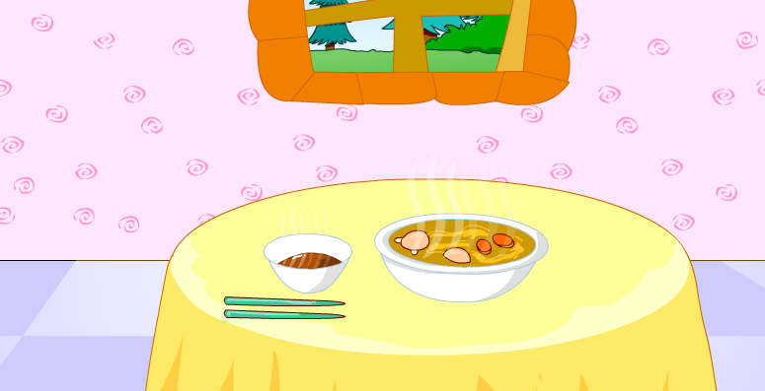
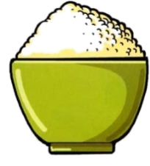
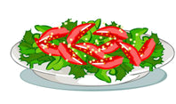
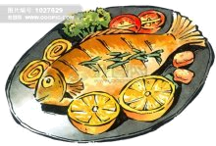

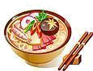
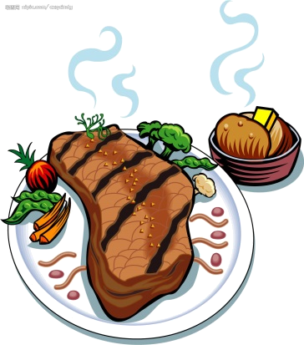
What do we need(需要） for dinner?
Notes:
Pre-task preparation 3:
活动内容：头脑风暴
操作方法：引导学生想一想需要什么餐具

Slide 7

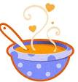
soup
Notes:
While-task procedure 4:
活动内容：单词学习
操作方法：儿歌巩固单词，同时思考吃什么食物的时候我们需要筷子
T: We need chopsticks for soup or for rice?
Yes, we need chopsticks for rice.

Slide 8
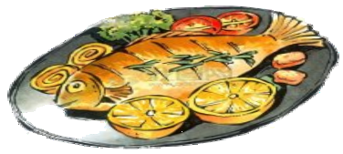
fish
Notes:
While-task procedure 10:
活动内容：单词学习
操作方法：引出单词，指导发音

Slide 9
beef
Notes:
While-task procedure 11:
活动内容：句型学习
操作方法：通过单词学习新句型

Slide 10
rice
Notes:
While-task procedure 13:
活动内容：单词学习
操作方法：引出单词，指导发音

Slide 11
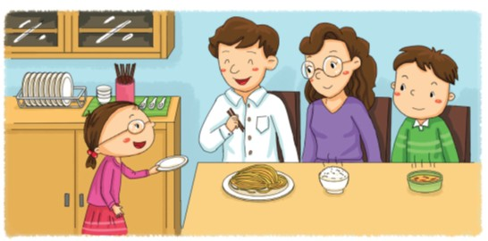
Dinner is ready!
How many plates?
A plate?
One plate.
No, thanks.
Notes:
While-task procedure 18:
活动内容：对话训练
操作方法：通过看图说话进行对话训练，学习完新句型后进行同桌互说
T: How many plates do they need?
Sa: One plate.
T: But Dad has one plate. So when the girl says “A plate?”
Dad says“No, thanks.”

Slide 12
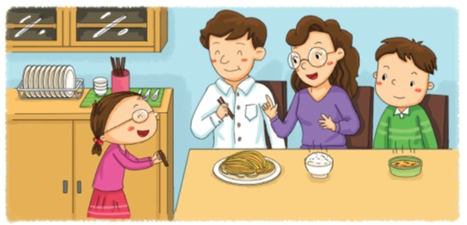
Dinner is ready!
Have some noodles.
Thank you.
Notes:
While-task procedure 19:
活动内容：对话训练
操作方法：通过图片进行对话训练，然后同桌互问，进行句型巩固
T: Mum is having some rice. What does she need?
Sa: Chopsticks.
T: So when Kitty asks “Chopsticks?”
Mum says“Yes, please.”

Slide 13
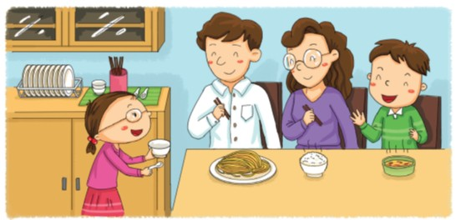
Dinner is ready!
Have some soup, please.
No, thanks.
Notes:
While-task procedure 20:
活动内容：对话训练
操作方法：通过图片进行对话训练，然后同桌互问，进行句型巩固
T: Ben is having some soup. What does he need?
Sa: A spoon.
T: Yes. So when Kitty says“A bowl?” he says “No,thanks.”
S2: Ask and answer

Slide 14


Read Student’s Book
Recite the dialogue . Read the new words.

Slide 15
谢谢大家！

